Slide 1
Workflow Recovery System
Eastern Eagles Team:
Mateusz Gołąb
Csaba Kerti
Jakub Kiełbasa
Zsolt Kollarits
Notes:
Sept 2010

Slide 2
Presentation Plan
Team Management
Goals and Objectives
Design Applied
Testing Strategy
Prototype Demonstration
Costs Identification
Summary and Discussion
Notes:
Sept 2010

Slide 3

Team Management
Quality
Quality
“Two different nations...
...one common belief!”
Quality
Quality
Quality
Quality

Slide 4

Team Management
Teamwork
Common management
Responsibilities
  Requirements
  Design
  Testing
  Implementation
There is no ‘I’ in TEAM

Slide 5
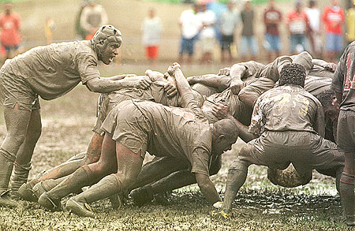
Team Management
Scrum Methodology
Releases
Sprints
Daily Scrums
  What have I done since last Scrum?
  What am I planning to do next?
  Any impediments?
Scrum Master(s)

Slide 6


Goals of the Project
Communication with Customer
Different points of view may cause...
Always involve Customer
User requirements
System requirements
No over specification
Notes:
Sept 2010

Slide 7



Goals of the Project
Main Requirements
Universal workflow tool
Efficient recovery mechanism
Versatile data format (XML)
Multi-platform software
Strongly interactive system
Security and safeness

Slide 8
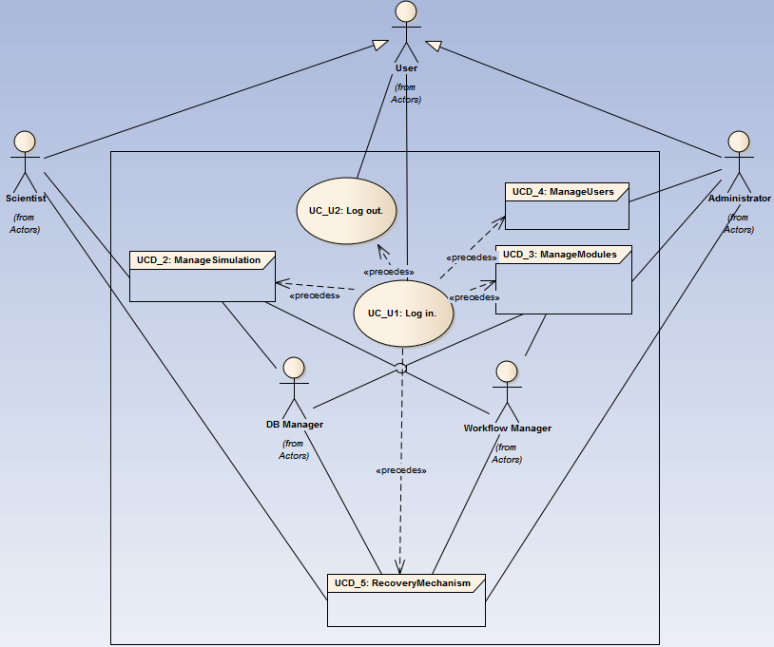
Goals of the Project
Use Case Diagram of the System

Slide 9
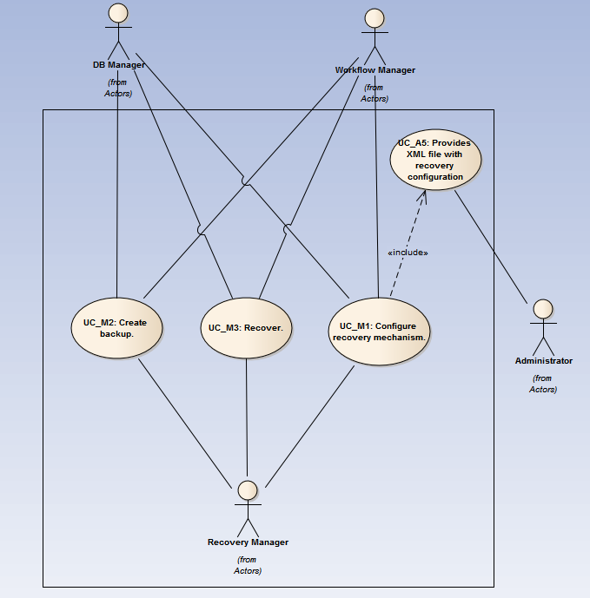
Goals of the Project
Use Case Diagram of the Recovery Mechanism

Slide 10
Design of the Project

Slide 11
Design of the Project

Slide 12
Design of the Project

Slide 13
Design of the Project

Slide 14
Design of the Project

Slide 15
Testing Strategy

Slide 16
Testing Strategy

Slide 17
Testing Strategy

Slide 18
Testing Strategy

Slide 19
Testing Strategy

Slide 20
Implementation

Slide 21
Implementation

Slide 22
Implementation

Slide 23
Demonstration

Slide 24
Costs

Slide 25
Costs

Slide 26
Costs

Slide 27
Summary

Slide 28
Question?

